Slide 1

SEXUAL HARASSMENT TRAINING
your annual corporate training guide to sexually harassing your coworkers

Slide 2






Whoops! Regular corporate training doesn’t work and isn’t enough to protect you…

Slide 3

CYA Sexual Harassment
Rebecca Long @amaya30
The Diana Initiative 2018

Slide 4



Hello! My name is _______.
Rebecca Long
@amaya30
Spokane, WA
Lead DevOps Engineer at RiskLens
Founder of Future Ada
@FutureAda

Slide 5

Training Overview
My experience
Define key terms
What do to before anything happens
What happens if/when something does happen
What to do if escalation is needed
Important things to remember
How to be an ally

Slide 6


Slide 7
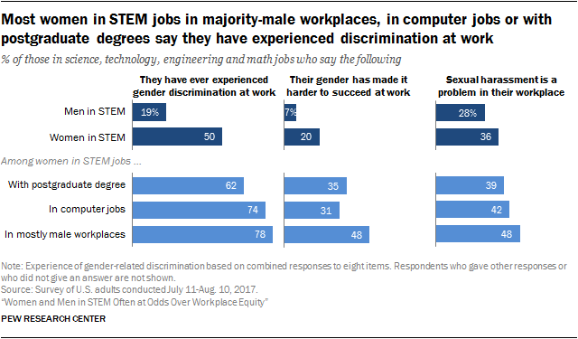

Slide 8

Definition Time!

Slide 9

The Sexual Harassment Handbook Linda Gordon Howard
@amaya30 | @FutureAda The Diana Initiative 2018

Slide 10

Laws prohibiting sexual harassment define sexual harassment as “unwanted” sexual behavior that affects an employee’s experience of the workplace in certain defined ways.

Slide 11


Slide 12

Gender Discrimination
Using derogatory language toward women
Joking during performance evaluations of women
Having women take minutes at meetings
Using women as surrogate wives to serve coffee, by personal gifts, organize parties, and take lunch orders

Slide 13

Gender Stereotyping
Having women employees concentrated in secretarial and assistant positions
Using female employees as lures for business dinners
Having few women in upper-management positions

Slide 14

Who is impacted?
Target
Harasser
Male / Female
Black / White
Gay / Straight
Blue collar / White collar / Pink collar
Supervisor / Coworker / Executive
Male / Female
Black / White
Gay / Straight
Blue collar / White collar / Pink collar
Supervisor / Coworker / Executive

Slide 15
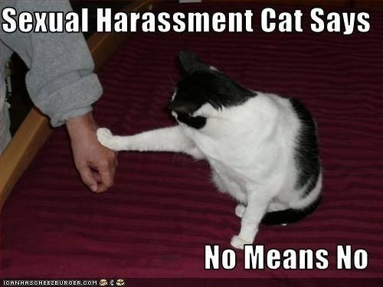
Remember!
If a comment or behavior makes you uncomfortable, it’s okay to bring up.
Don’t listen to anyone who might say you are being “too sensitive.”

Slide 16

CYA Before Anything Happens

Slide 17

Educate Yourself
Know your rights as an employee
Right to not be discriminated against
Right to not be harassed
Right to decent and safe working conditions
Know the corporate policies
What does your employer define for harassment?
What is the reporting process for your company for problems?

Slide 18

Daring to set boundaries is about having the courage to love ourselves, even when we risk disappointing others.
Rising Strong, Brene Brown

Slide 19

Document everything!
Put complaints or problems in writing
Email is your friend!
Keep conversation history turned on
Screenshot things you can’t save in text form
Take notes during or immediately after a meeting
@amaya30 | @FutureAda The Diana Initiative 2018

Slide 20

Oh no! Something happened. Now what?

Slide 21



Slide 22
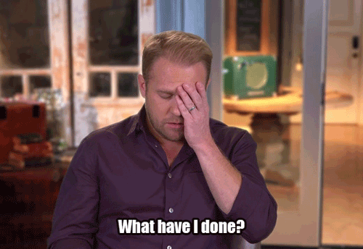

Slide 23

Innocent Mistake?
Some people are really just clueless
Good idea to assume the best of people
Talk to the person who crossed the line
We have an opportunity to help others learn

Slide 24

@amaya30 | @FutureAda The Diana Initiative 2018

Slide 25

Some People are Actually Just A-Holes

Slide 26

Escalation time…

Slide 27
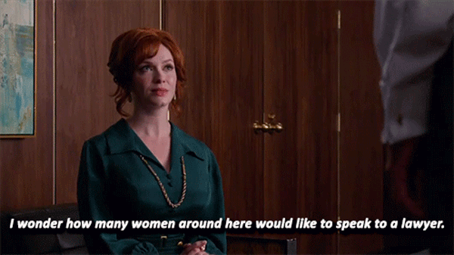
Internal Escalation Options
Talk to management
Only if it’s safe to do so!
Talk to Human Resources (HR)
Beware… HR’s job is to protect the company… not necessarily to help or protect you

Slide 28

Equal Employment Opportunity Commission (EEOC)
File complaints online: https://www.eeoc.gov/
File sooner rather than later
Time limit for “relevant” issues…
To Use Federal Law: 300 days
To Use State Law: 180 days

Slide 29

Legal Options
First… know your rights: http://www.legalvoice.org/sexual-harassment-at-work
Bring your notes and evidence to the lawyer to review
Understand…
the cost before moving forward
the emotional rollercoaster that will happen
it can drag out over years of your life
your employer will be digging through all your private information to use against you
Learn about Ellen Pao’s story

Slide 30
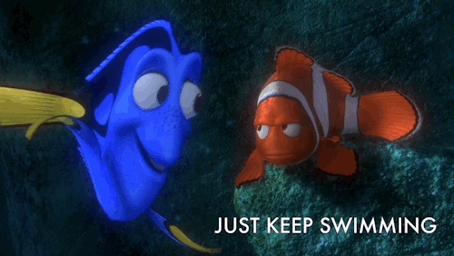
Important Reminders

Slide 31

Self Care is Critical

Slide 32
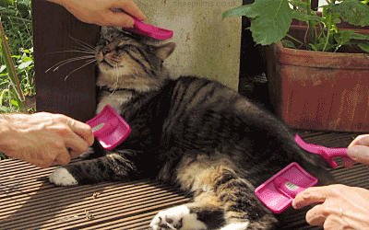
Self-Care Tips
This Stress is Real and Damaging
Have an Emergency Self Care Plan
Physical Self Care
Creative Outlet
Have a Support Community
Practice Expressing Your Personal Boundaries
It’s Okay to Walk Away

Slide 33

Be an ally!
Listen & believe survivors
Again…
BE BRAVE!
Speak up! Call it like it is
Check out this Guide for Allies: https://www.betterbrave.org/allies/

Slide 34

Wrap Up…

Slide 35


Slide 36
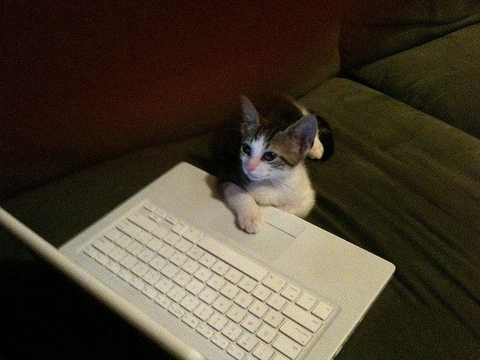
More Resources
Books:
“The Sexual Harassment Handbook” by Linda Gordon Howard
“Sexual Harassment of Working Women: A Case of Sex Discrimination” by Catharine A MacKinnon
Better Allies https://maleallies.com/
LeanIn https://leanin.org/sexual-harassment
RAINN (Rape, Abuse & Incest National Network) https://www.rainn.org/ThatsHarassment

Slide 37

Thank You!
Rebecca Long
Web: http://rebeccalong.tech
Email: rebecca@futureada.org
Social: @amaya30
Future Ada
Web: http://futureada.org
Email: hello@futureada.org
Social: @futureada

